Slide 1
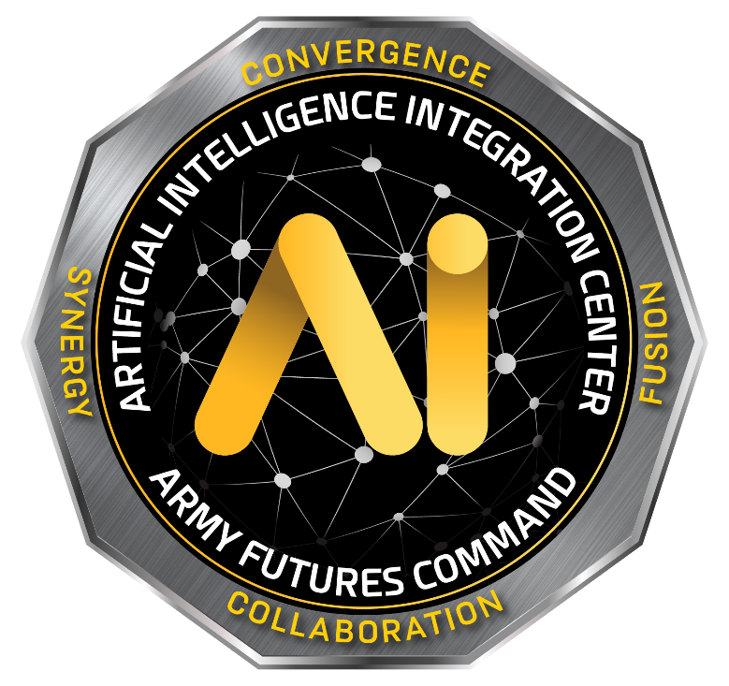

A2IT Framework
Functionality
AI2C ML Ops Team
IMT
Robustness
(1) Assumptions
Costs
SDMT
Final Model
(2) Baseline
Scalability
(3) Performance Metric
…
(4) ML-TE
STOP
Systems Team / Stakeholders

